Slide 1
Intro to reactjs
CSAG Private Session #4

Slide 2
Github intro-react
https://github.com/CSAG/intro-react

Slide 3
How website works?

Slide 4
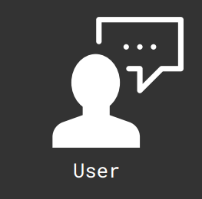

Slide 5


Slide 6
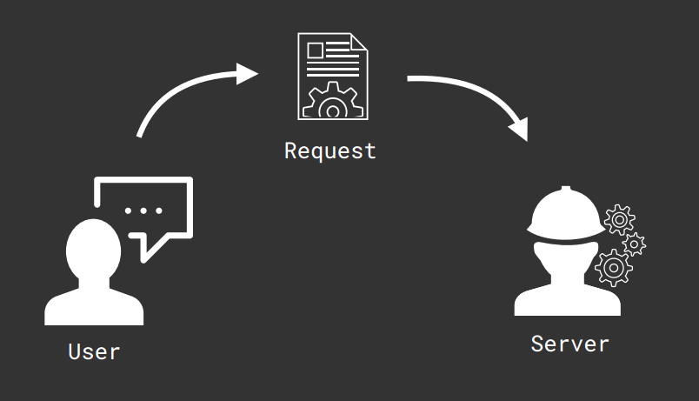

Slide 7
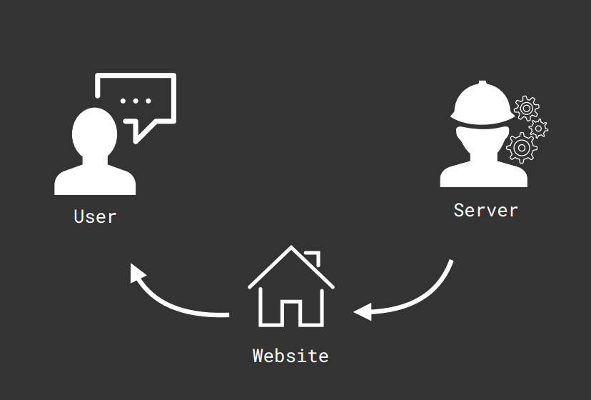

Slide 8
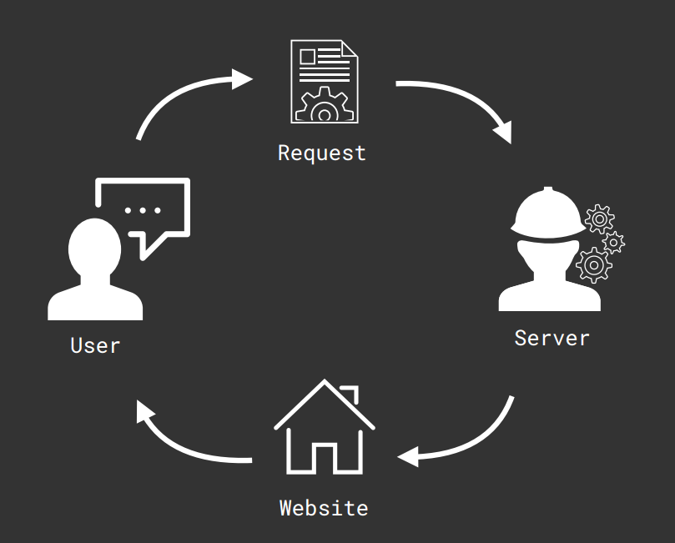

Slide 9
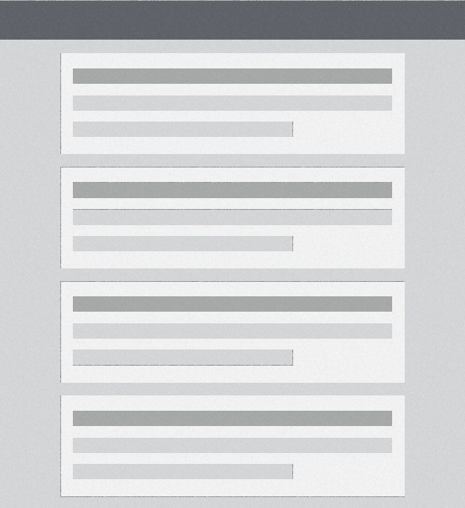

Slide 10
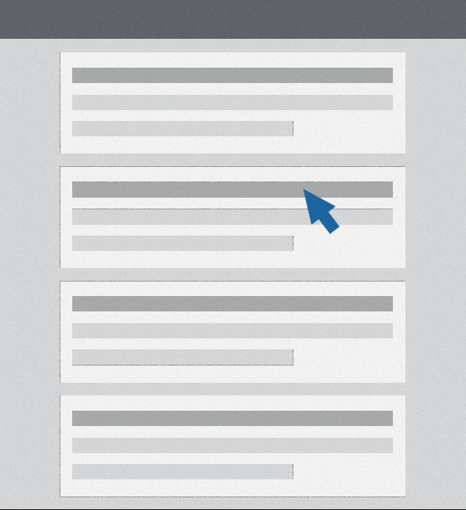

Slide 11


Slide 12


Slide 13


Slide 14
What is SPA?
Single Page Application

Slide 16
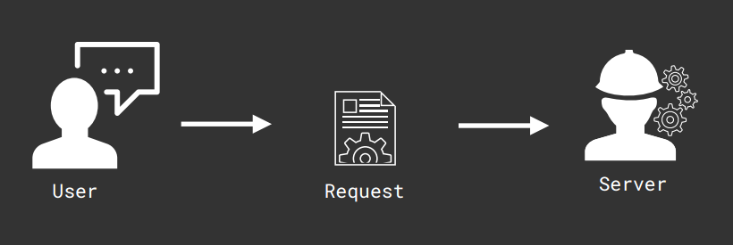

Slide 17
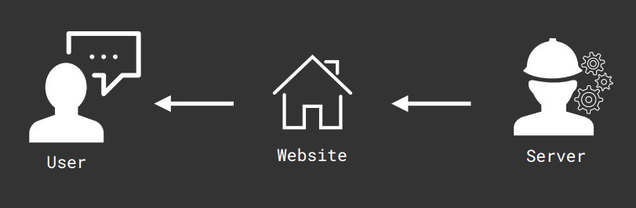

Slide 18
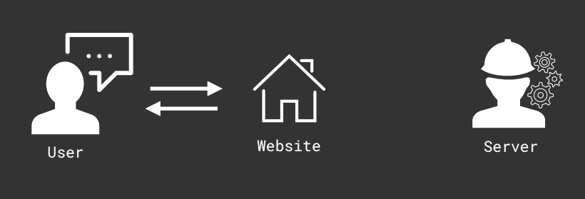

Slide 19
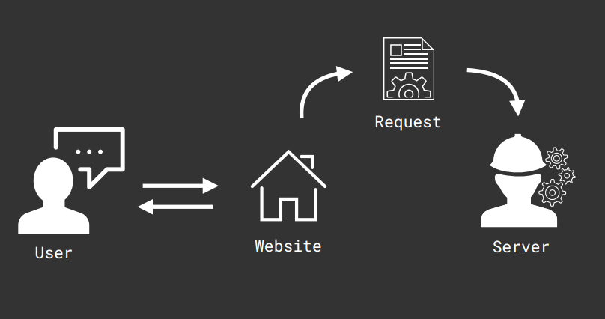

Slide 20
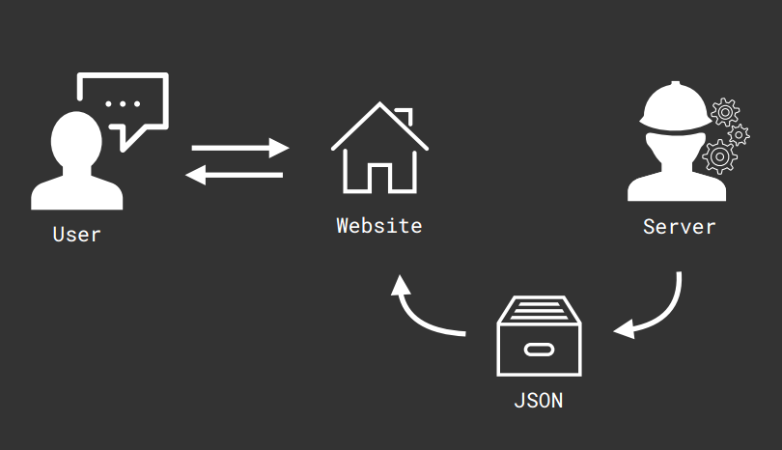

Slide 21
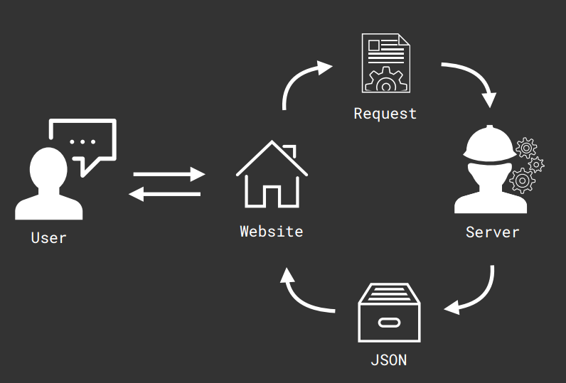

Slide 22
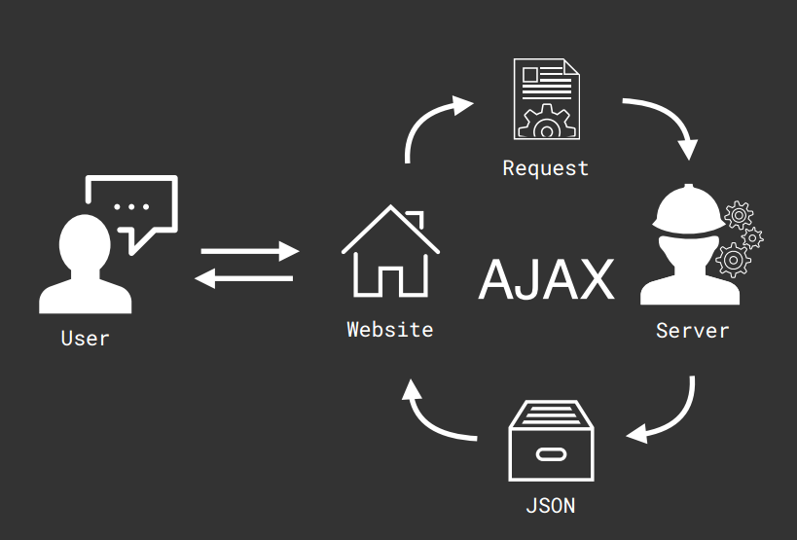

Slide 23
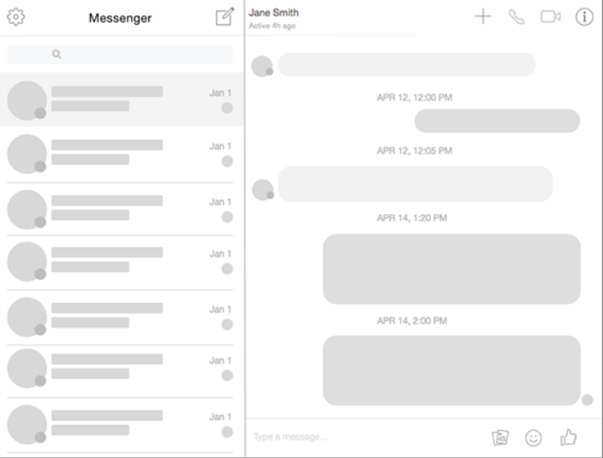

Slide 26


Slide 27


Slide 28
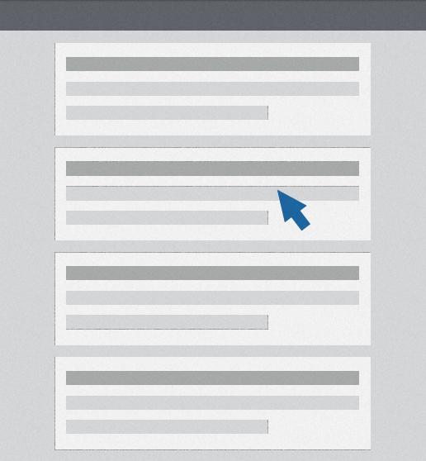

Slide 29
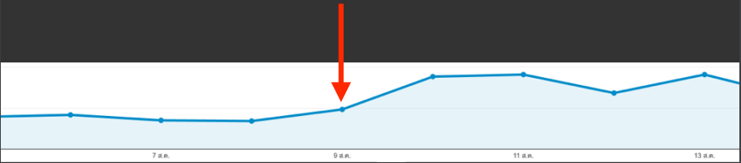
Start using SPA
Average Session Duration

Slide 30
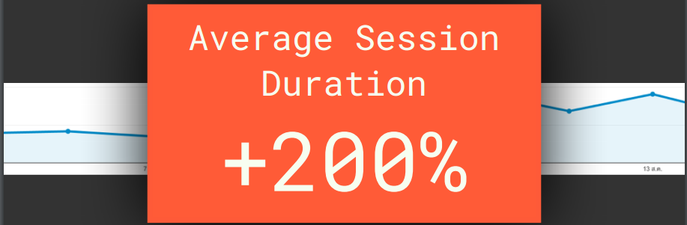
Start using SPA

Slide 31
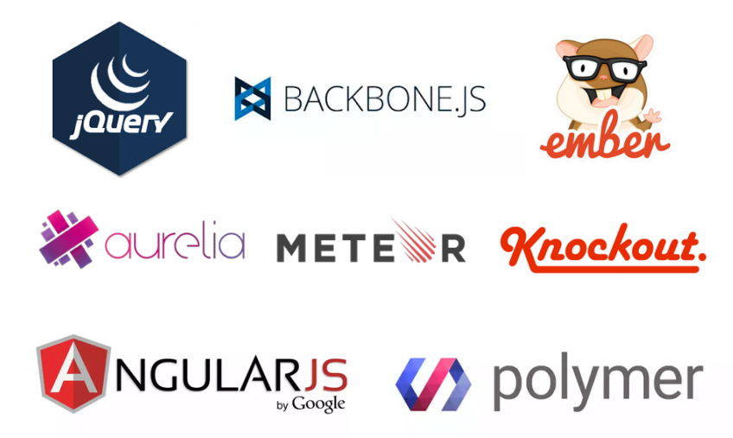

Slide 32


Slide 33


Slide 34


Slide 35
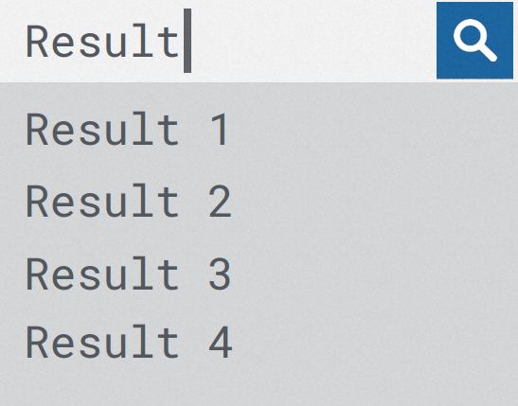

Slide 36


Slide 37


Slide 38
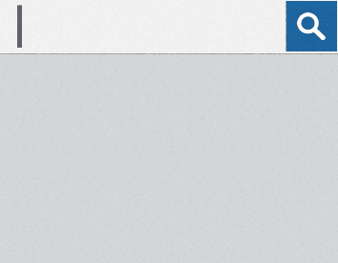
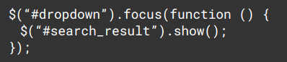

Slide 39
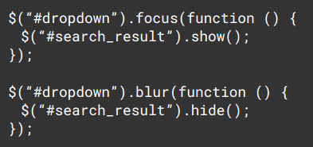

Slide 40
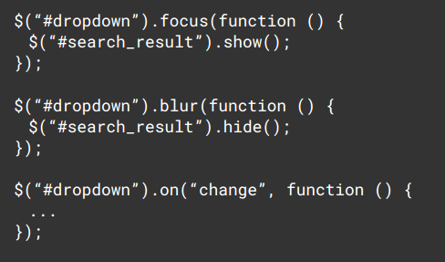

Slide 41
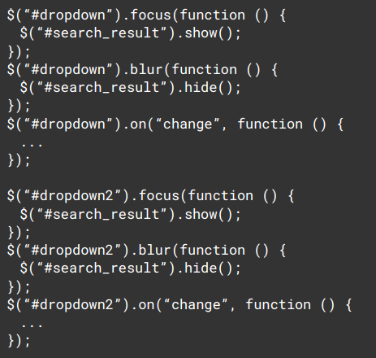

Slide 42
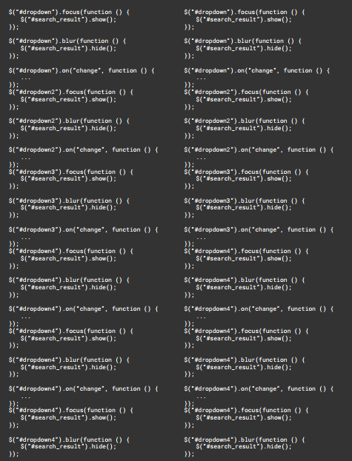

Slide 43
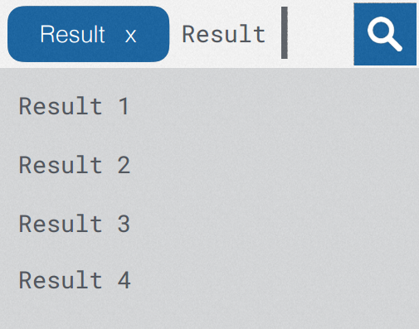

Slide 44


Slide 45
3 Reasons
Why you should use ReactJS?

Slide 46
Reason 1
Break UI
to components

Slide 47
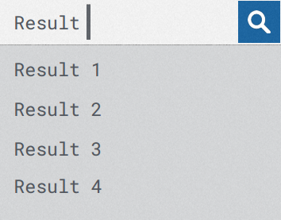
<Dropdown />

Slide 48
Component
<Dropdown />

Slide 49
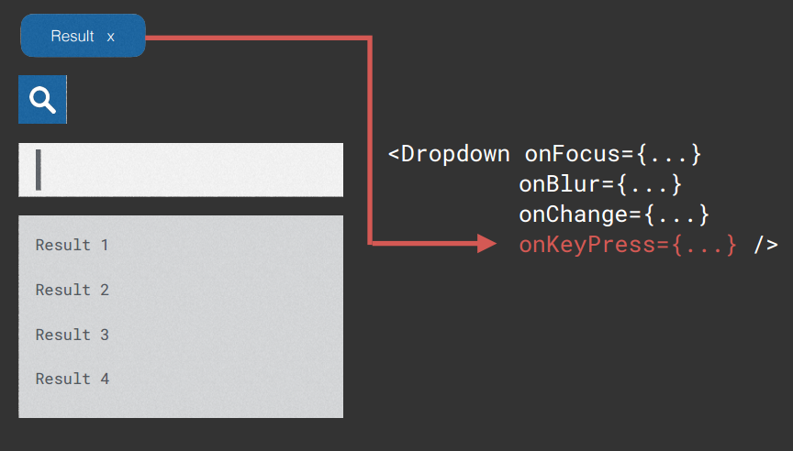

Slide 50
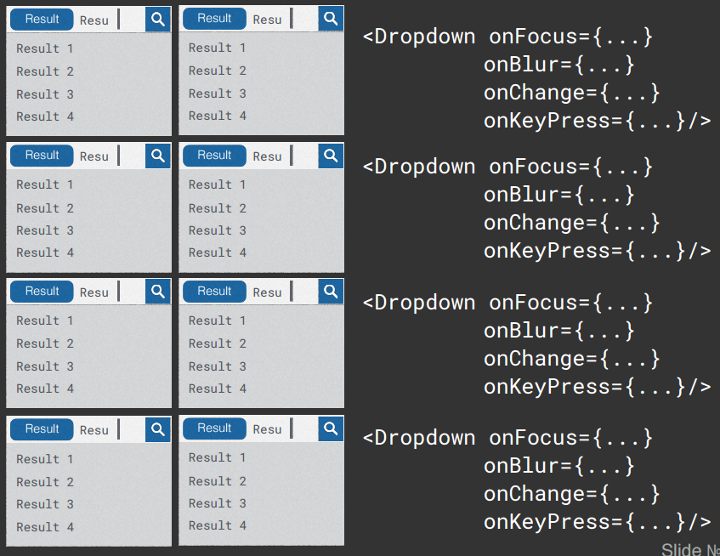

Slide 51
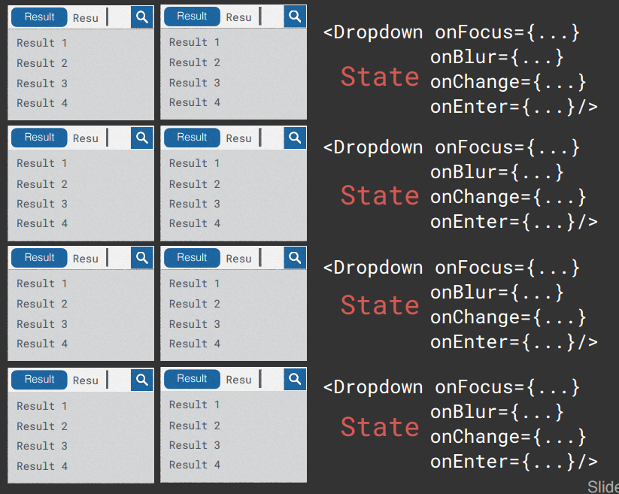

Slide 52
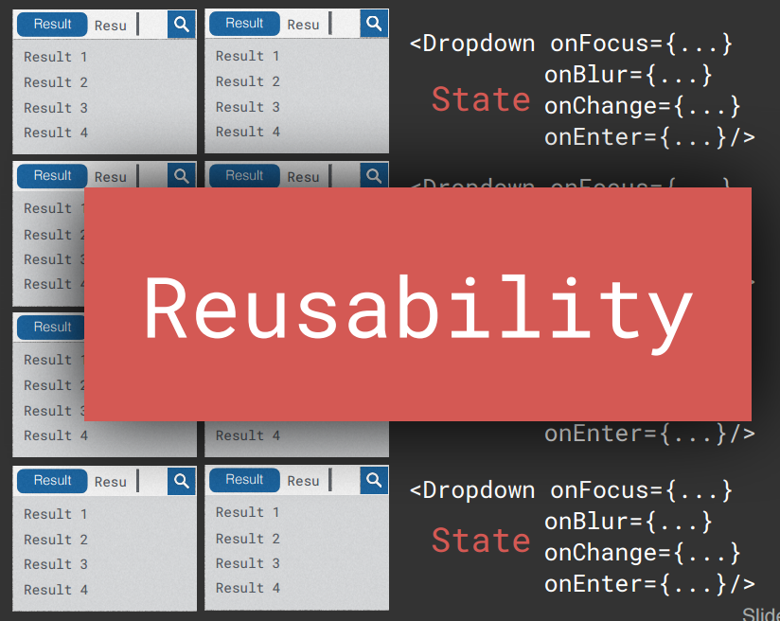

Slide 53
Reason 2
Performance

Slide 54
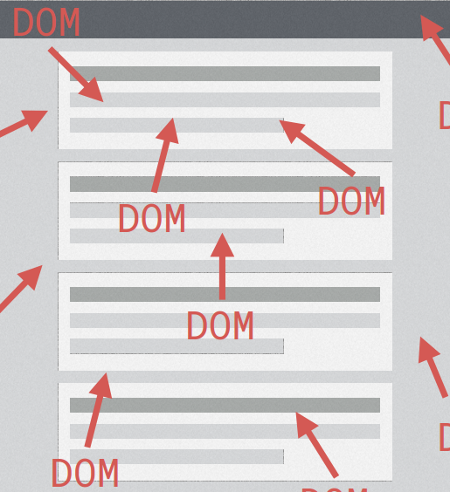

Slide 55
DOM

Slide 56
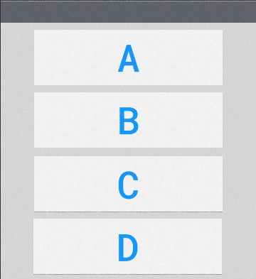

Slide 57
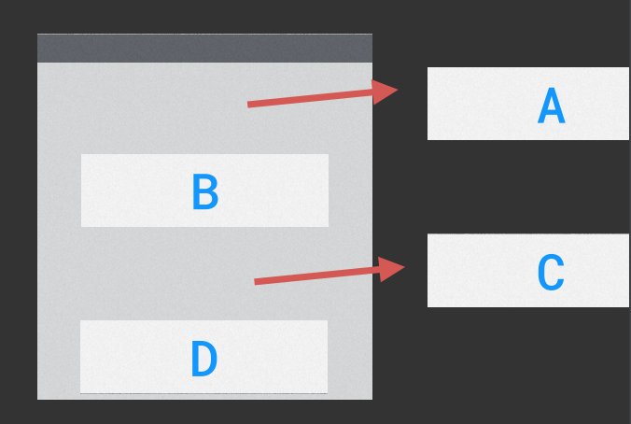

Slide 58
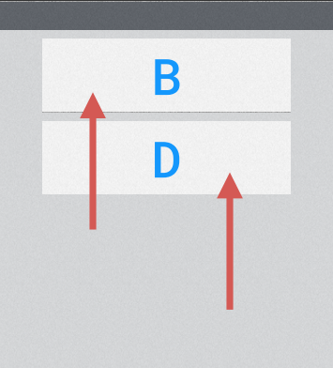

Slide 59
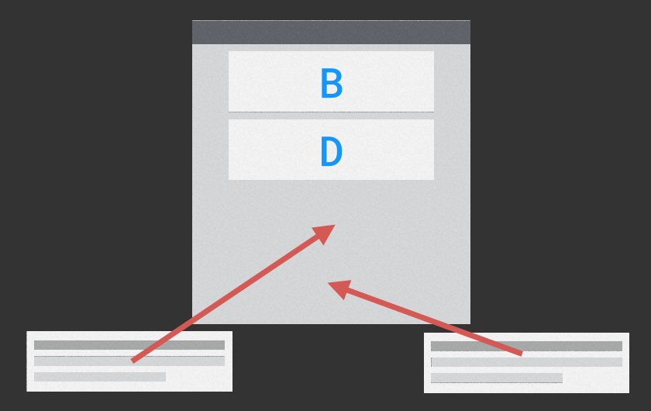

Slide 60
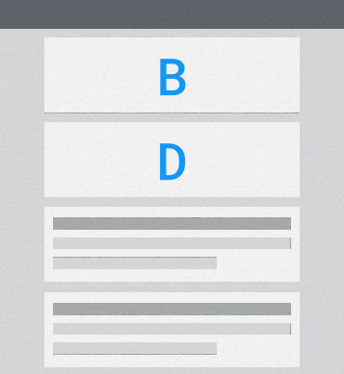

Slide 61
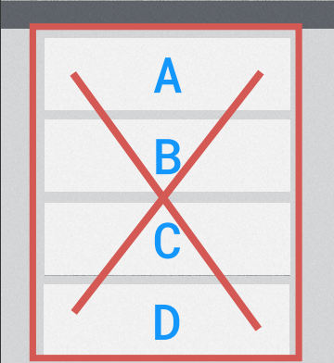

Slide 62


Slide 63
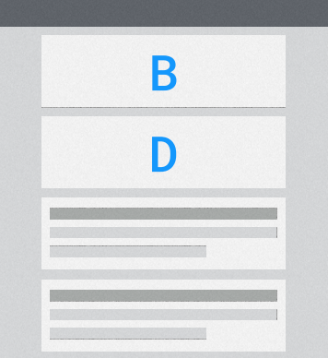

Slide 64
Virtual DOM

Slide 65
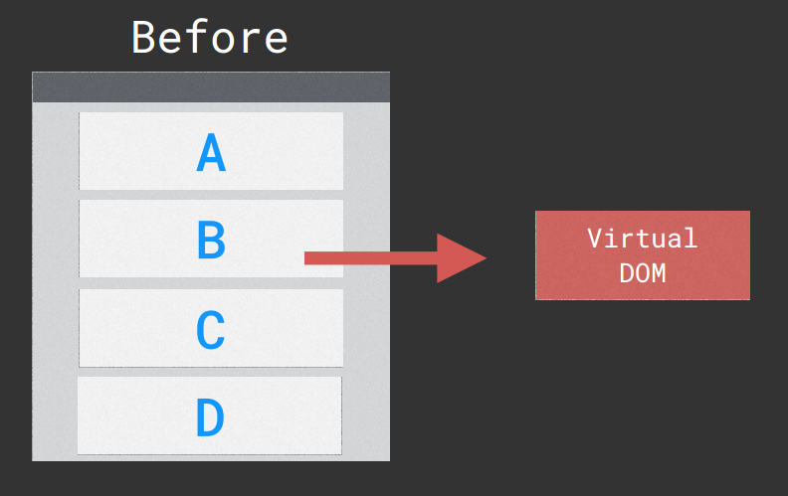

Slide 66
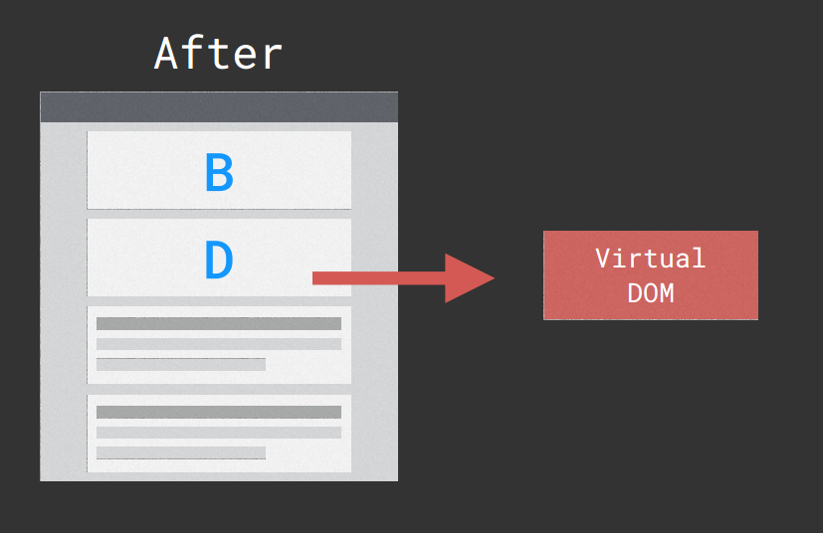

Slide 67
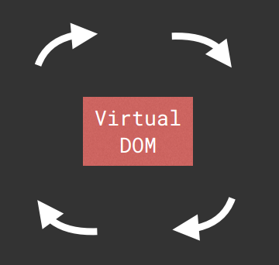

Slide 68
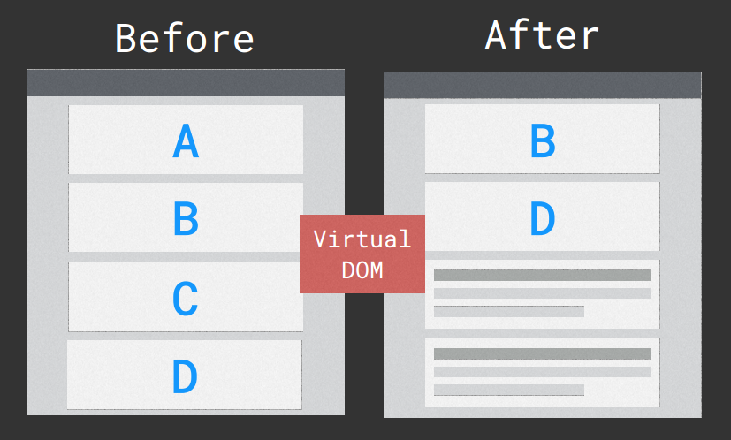

Slide 69
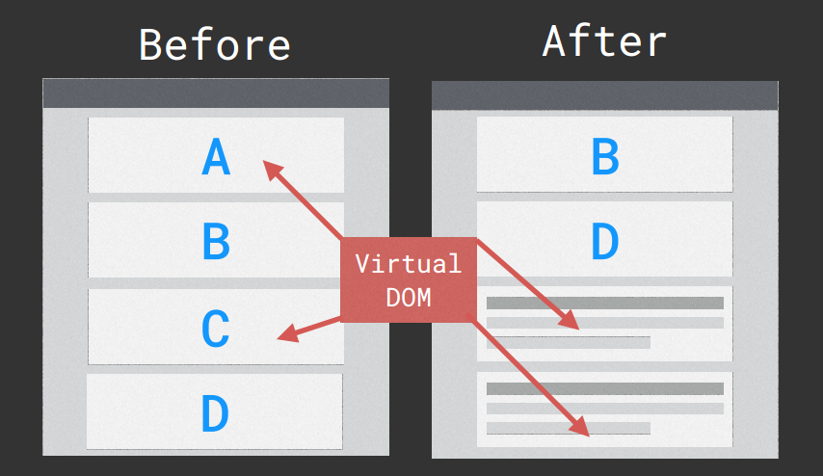

Slide 70
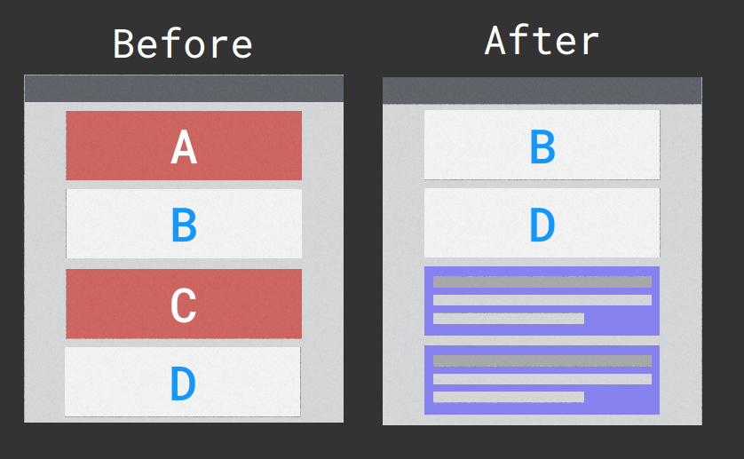

Slide 71
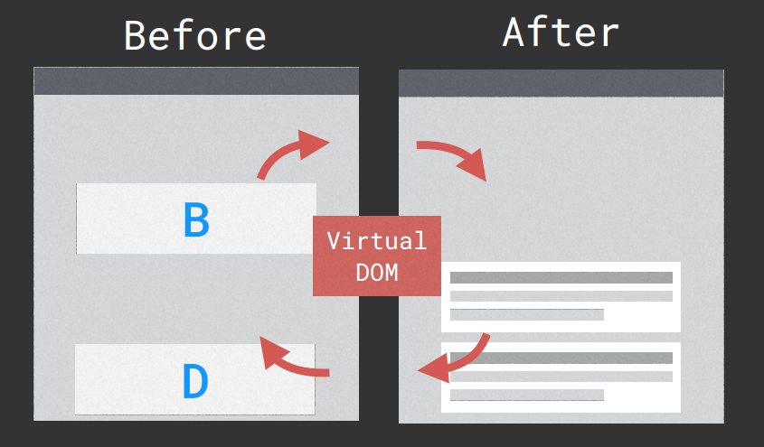

Slide 72
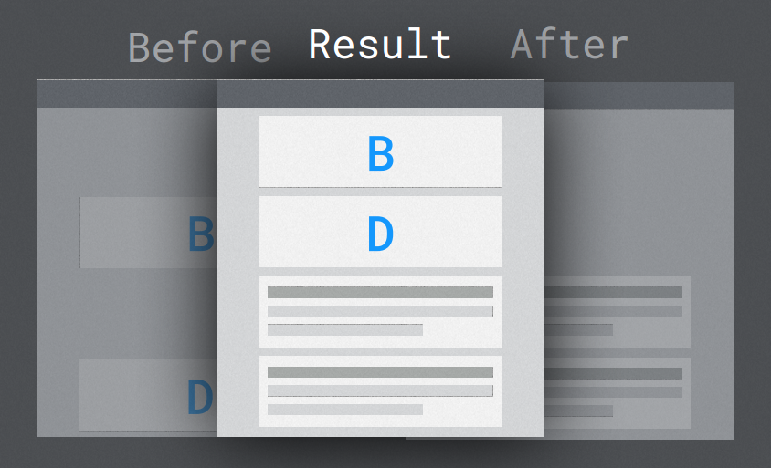

Slide 73
Reason 3
Believe in facebook

Slide 74
Reason 3
Believe in facebook
Ecosystem

Slide 75


Slide 76
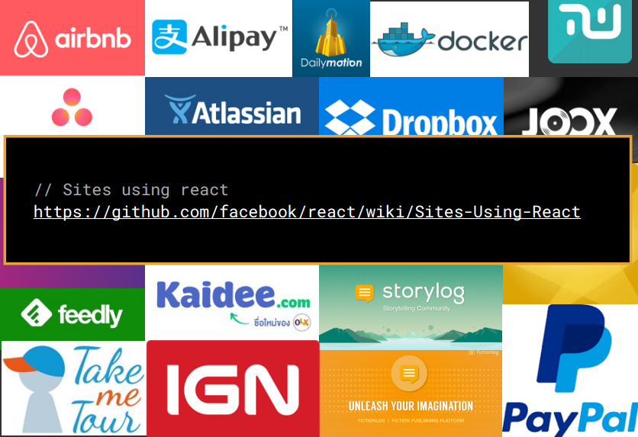

Slide 77
How to start
ReactJS project?

Slide 78


Slide 79


Slide 80
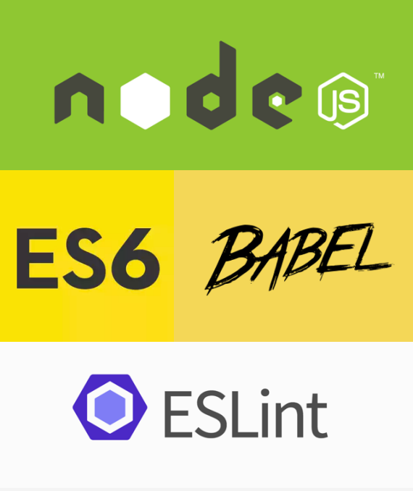

Slide 81
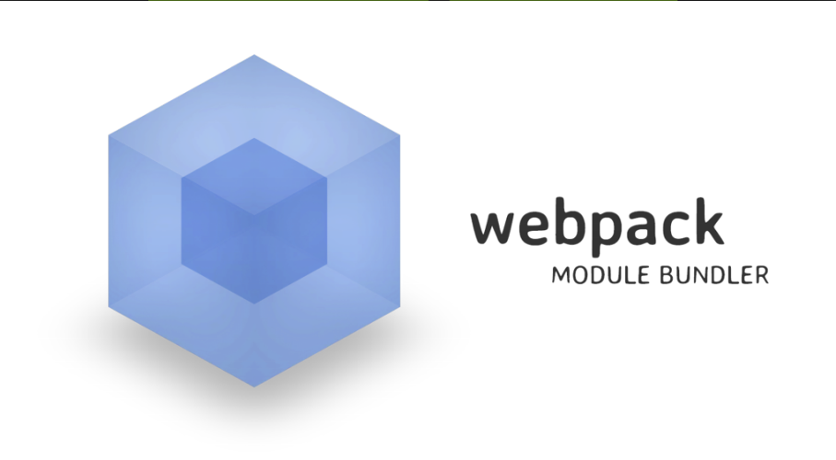

Slide 82

Dependencies

Slide 83
Today
We have shortcut...

Slide 84


Slide 85


Slide 86


Slide 87
One more thing

Slide 88


Slide 89
Two more thing

Slide 90


Slide 91


Slide 92


Slide 93
Three more thing

Slide 94


